Slide 1
OneStone AI System
Architecture

Slide 2
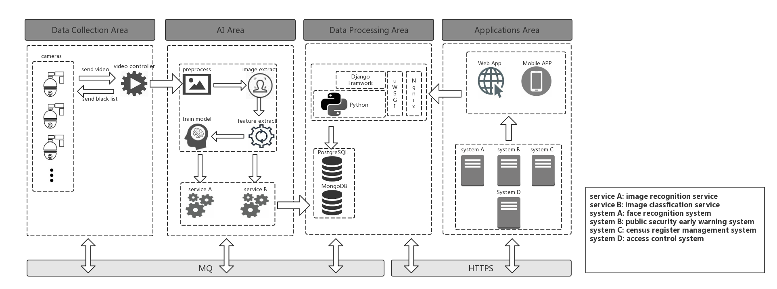
Freamwork

Slide 3
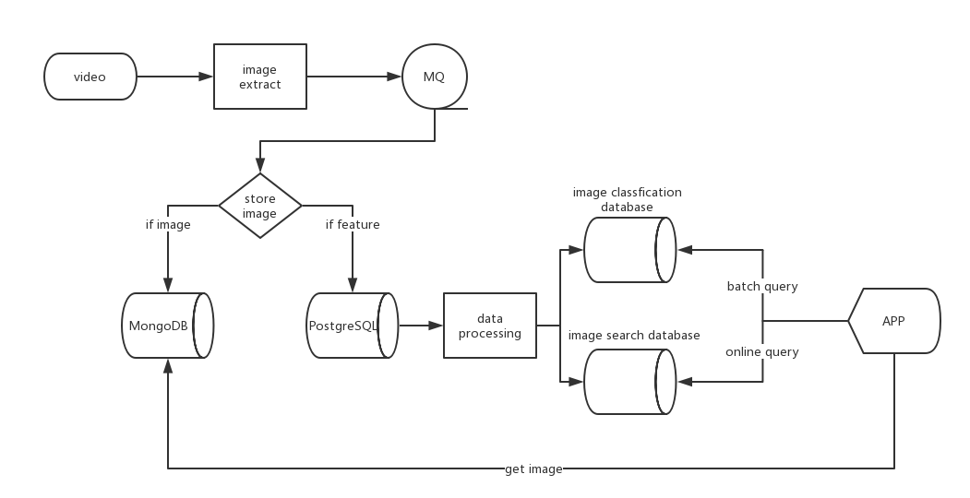
data flow

Slide 4
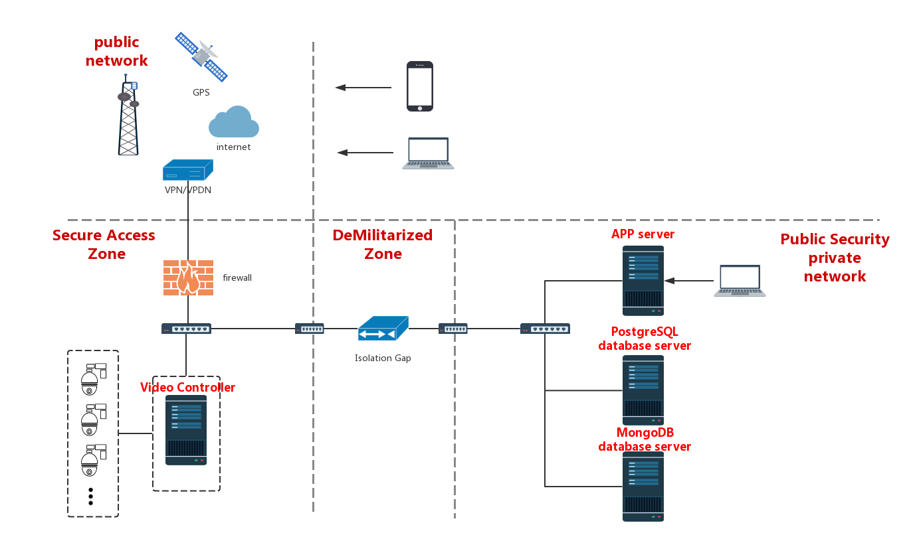
network topology

Slide 5
One Stone core technology
1
Human face feature extraction and feature model tranning
2
Search from massive face feature library
3
Object detection and recognition
4
Image enhancement processing
5
Automation machine learnning
6
Crawl across the net
7
Transfer learnning

Slide 6
THANKS FOR WATCHING

